Slide 1
Neural Networks for Neural Networks
Using EEG Scans to Detect Alcoholism in Patients
Zooey Nguyen, Suyash Kumar, Nick Millkey, Max Kroft

Slide 2
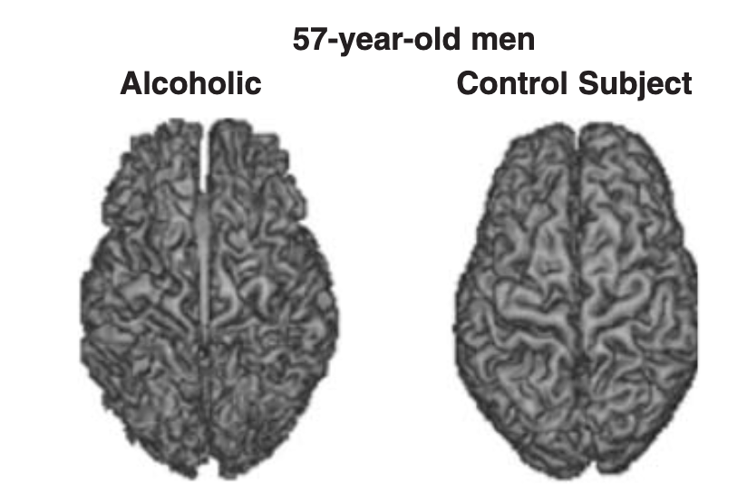
Alcoholism is a psychological disorder
Notes:
https://www.researchgate.net/publication/8406770_Alcoholism_and_the_brain_An_overview

Slide 3

Early intervention is key to treatment
AUDIT gives 70-90% accuracy
Notes:
https://getthematic.com/insights/content/images/wordpress/2018/04/shutterstock_730381336.jpg
Dawson, D.A., Grant, B.F., Stinson, F.S. and Zhou, Y. (2005), Effectiveness of the Derived Alcohol Use Disorders Identification Test (AUDIT-C) in Screening for Alcohol Use Disorders and Risk Drinking in the US General Population. Alcoholism: Clinical and Experimental Research, 29: 844-854. https://doi.org/10.1097/01.ALC.0000164374.32229.A2
current diagnosis of alcoholism is a well-tested psychiatric assessment called AUDIT (Alcohol Use Disorder Identification Test)
gold standard questionnaire asking people about their actual use and history, agrees with 70-90% of actual alcoholism diagnoses
in treatment, prevention is key—what if predisposition affects the way the brain works before actual trauma?
important first step is seeing if there are physiological differentiators in alcoholics
other work should look into if these differences show up beforehand too

Slide 4
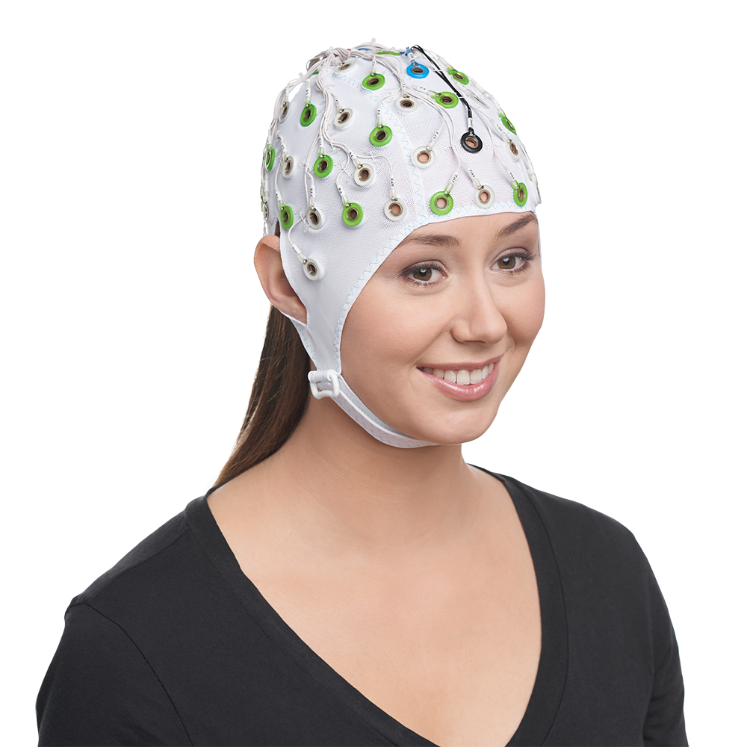
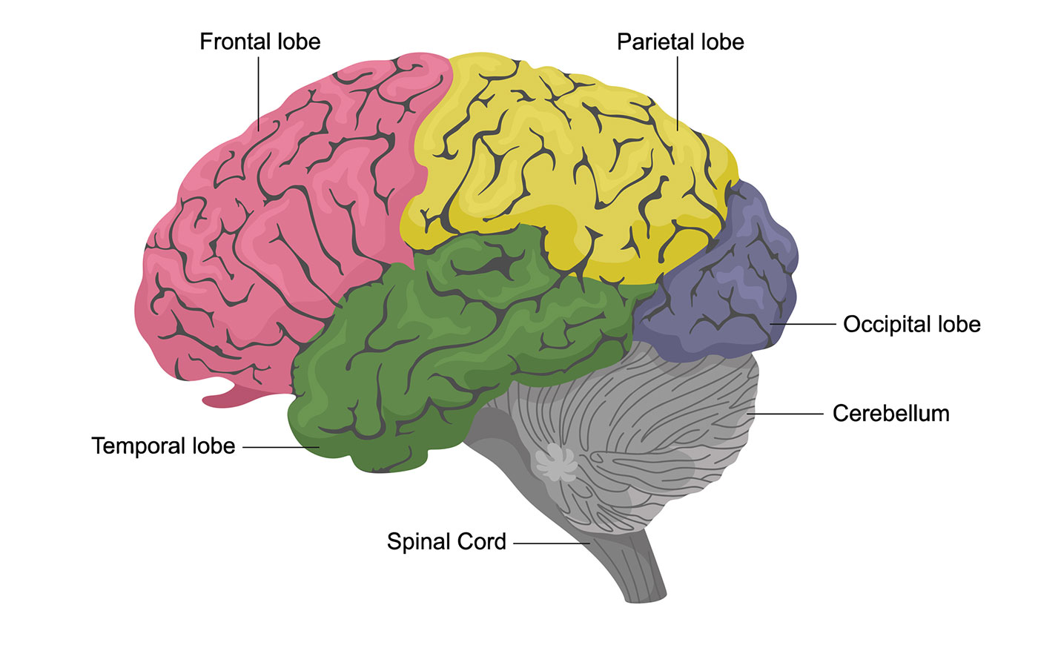
EEG tracks electrical activity in the brain
electroencephalogram
Notes:
https://www.hopkinsmedicine.org/health/conditions-and-diseases/anatomy-of-the-brain
https://brainvision.com/products/braincap-mr/
alcoholism affects different things than just alcohol
reward pathway in the amygdala/nucleus accumbens/temporal lobe
impulsivity and executive function in the frontal lobe
motor skills in the parietal lobe, nervous system
also large comorbidity rate with other mental illnesses and behavioral disorders
bunch of ways to track brain activity but here’s one
EEG is really coarse spatially (just a bunch of electrodes all over) but can capture tons of samples really fast
should have some information about WHERE in the brain is activated WHEN
alcoholics will prob differ from non alcoholics in functioning
certainly in response to alcohol triggers
what about generic ones ?

Slide 5
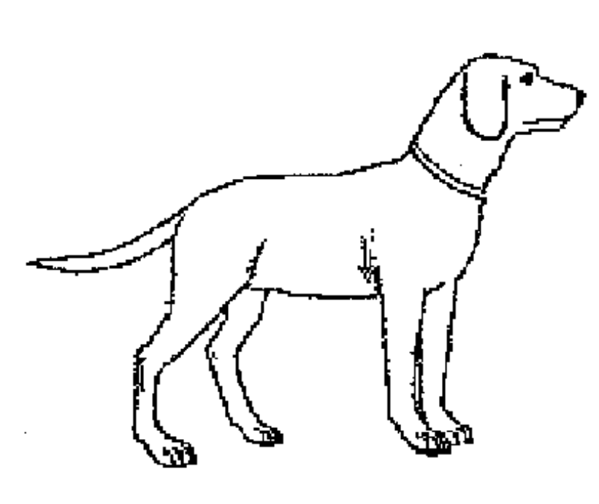
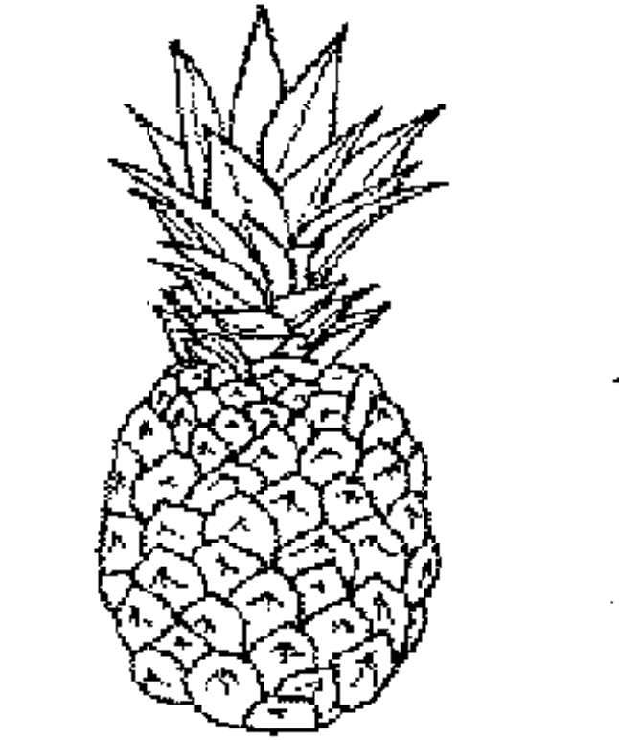
THE BIG PICTURE (Snodgrass and Vanderwart set)
S1
S2 match
S2 nonmatch
Notes:
https://www.researchgate.net/profile/Ramaswamy-Palaniappan/publication/3303075/figure/fig1/AS:394679418933251@1471110314661/Some-objects-from-the-Snodgrass-and-Vanderwart-picture-set.png
OBJECTIVE: use EEG time series data for subjects exposed to three different types of stimuli to identify if a subject is an alcoholic or not.
The stimuli are pictures selected from the Snodgrass and Vanderwart picture set.
The 3 stimuli:
A single image (S1)
Two matching images (S2 match)
Two non-matching images (S2 non-match)
EEG electrodes are sampled at 256 Hz for 1 sec
INTERESTING BASELINE
mostly neutral images of objects & things
not emotional responses as usually expected since alcoholism affects
different classifiers for each stimulus
why ? there’ll be a structural difference in where is activated
example: if certain parts of the brain are activated when you see a dog, another part will be when you see an identical dog, and a very different part when you see a pineapple

Slide 6
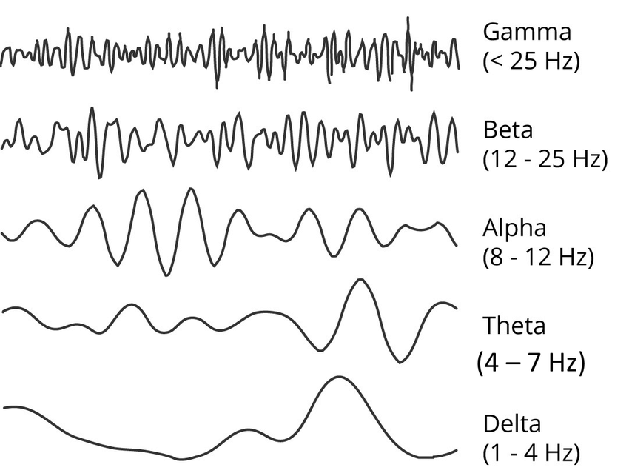
Standard preprocessing for EEG
Notes:
obviously neuroscientists have done a lot of work before us
usually identify five main frequency bands of significant brain activity (brain signals go WOOwoo)
apply low-pass, high-pass, certain frequency filters
but! our data covers such a small timeframe…
with enough data, our high-level noise can be modulated out with a good model
(we actually tried filtering, normalisation, and frequency transforms, and none of them made a significant difference due to our dataset size— see next!)
standard practice with fourier transform
cut off below 0.1 Hz (10 second long cycles, baseline movement of the brain)
cut off high around 30-100 Hz (rapid movement relating to physical activity, blinking, etc)
a narrow cutout around 50-60 Hz ()
filtering out noise
wavelet transform, smooth out each wavelet (literally hundreds of possibilities)
SVD algorithms (generalisation of PCA)
While manual feature engineering would have been helpful to try out simple classification algorithms, we ran out of time to pursue this approach further given the difficulty of manual dimensionality reduction.
We need some algorithm that could automatically pick up important features in samples existing within extremely high dimensional spaces … NEURAL NETWORKS!
https://www.researchgate.net/figure/Decomposition-of-the-EEG-signal-into-different-frequency-bands-8-Each-frequency-band_fig4_323142453

Slide 7
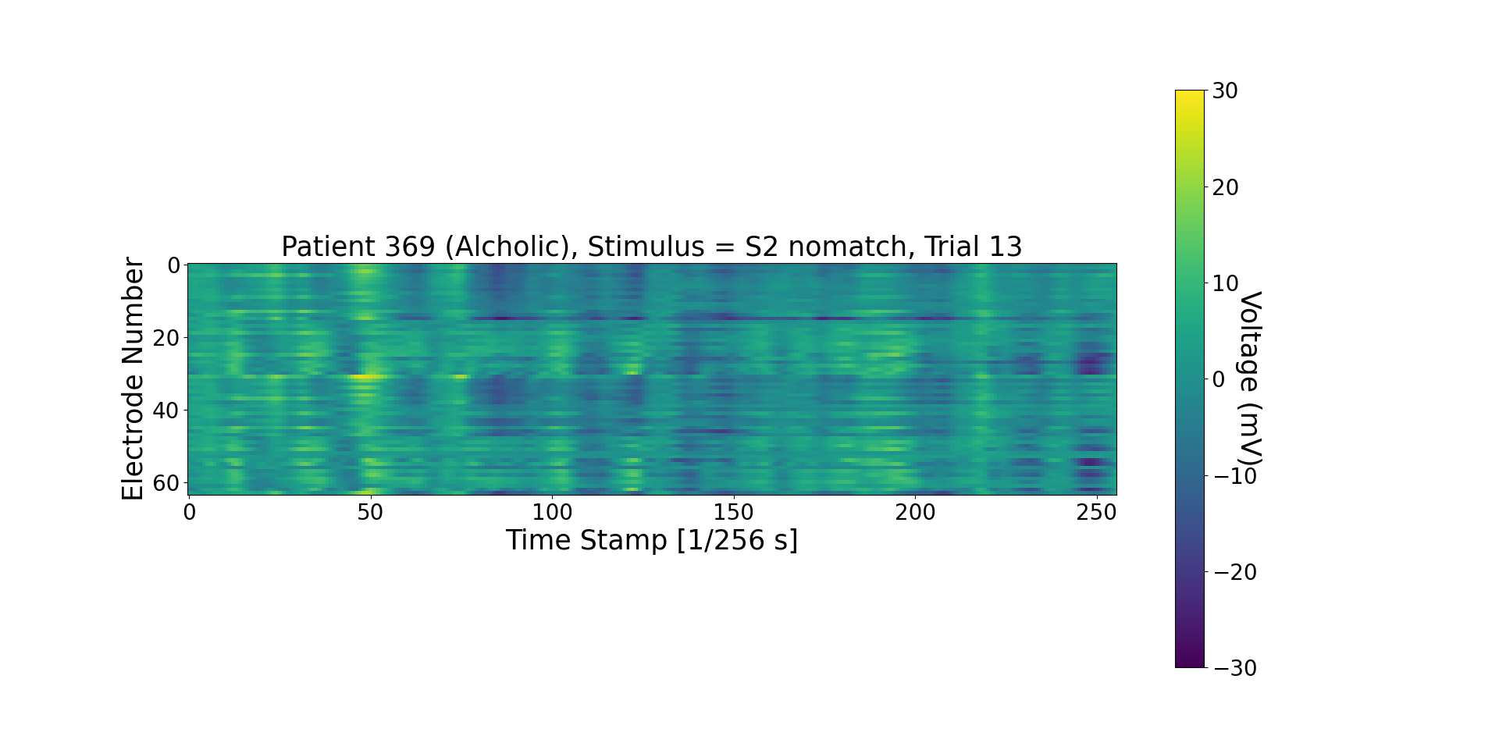
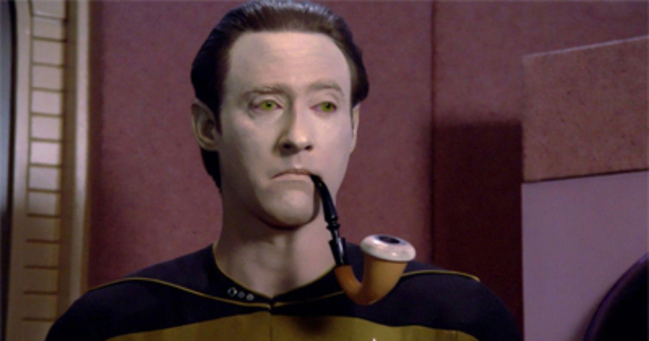
Data exploration
Notes:
https://static0.srcdn.com/wordpress/wp-content/uploads/2020/02/data-crimshaw-pipe-star-trek-the-next-generation-Edited-1.jpg
In the full dataset, we have 122 patients each with 120 trials. In a given trial for any patient, voltages are recorded over 256 timestamps from 64 electrodes.
This means we have ~15k samples in a ~16k dimensional space! Can we get rid of some electrodes and avoid looking at all timestamps? This would allow us to use a simpler ML model to perform classification.
Fortunately we have a pre-selected “training set” (20 patients with 30 trials each) to try feature engineering on!

Slide 8
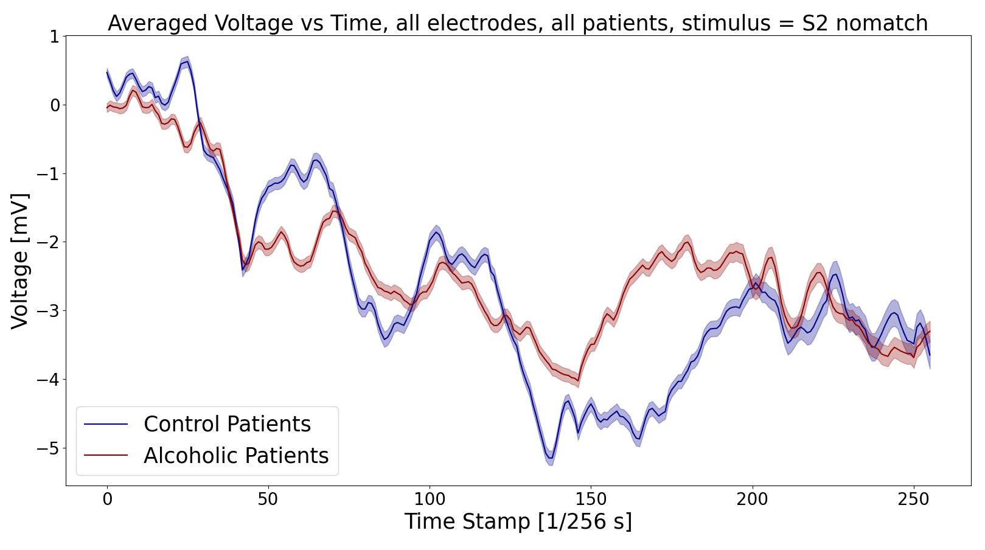
Average trends in the data
Shows potential for feature engineering
But what happens when we look at individual patients?

Slide 9
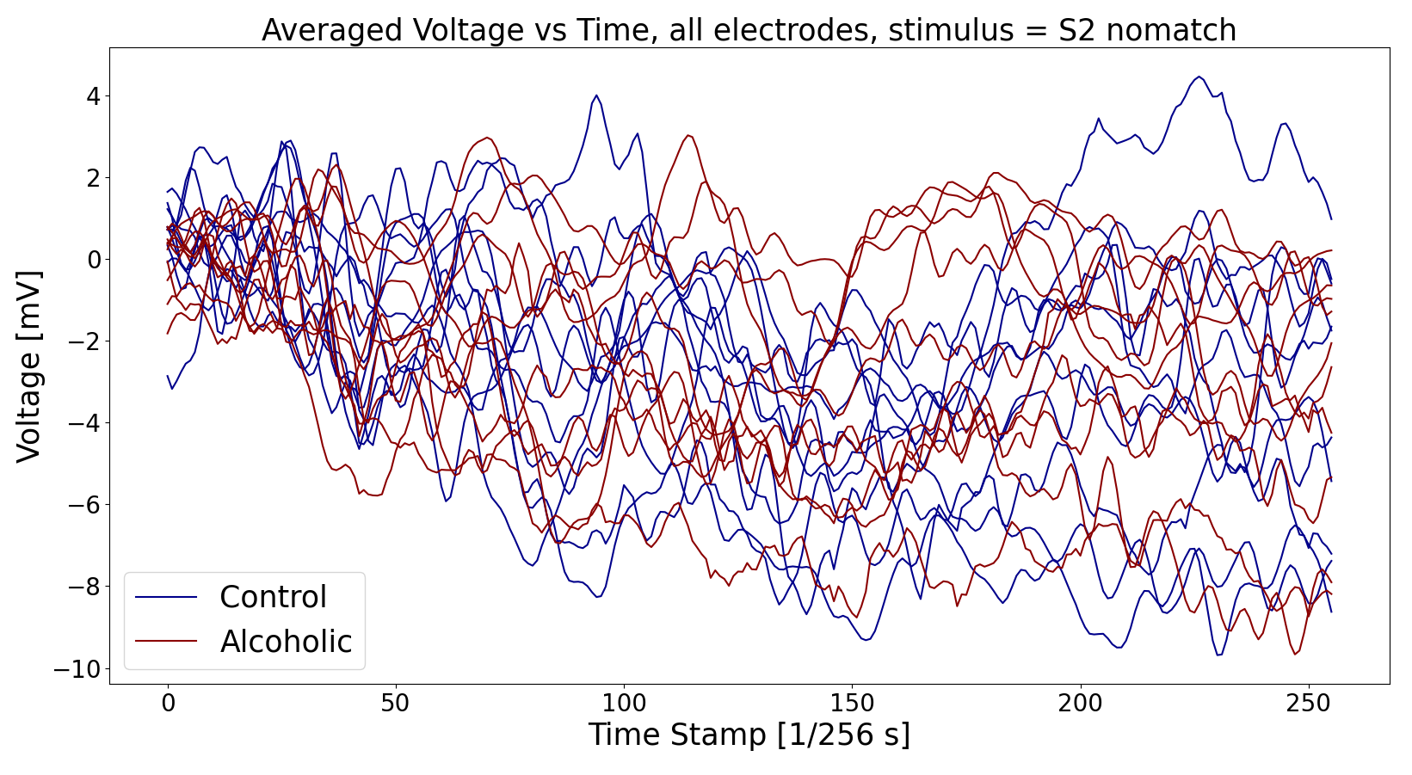
Variance across patients
The high variance among patients may make feature engineering inaccurate
What about making features out of trends between trials of the same patient?

Slide 10
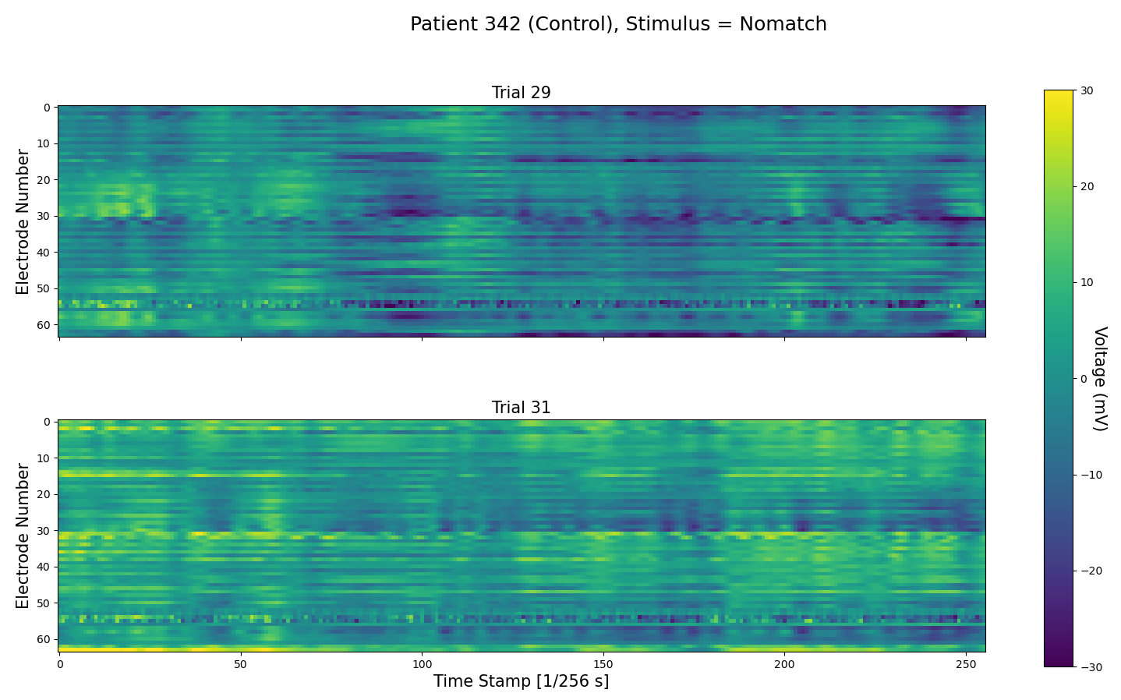
Different trials, same patient, same stimulus
Signals vary greatly in the two adjoining images
Manual feature engineering is turning out to be tedious

Slide 11
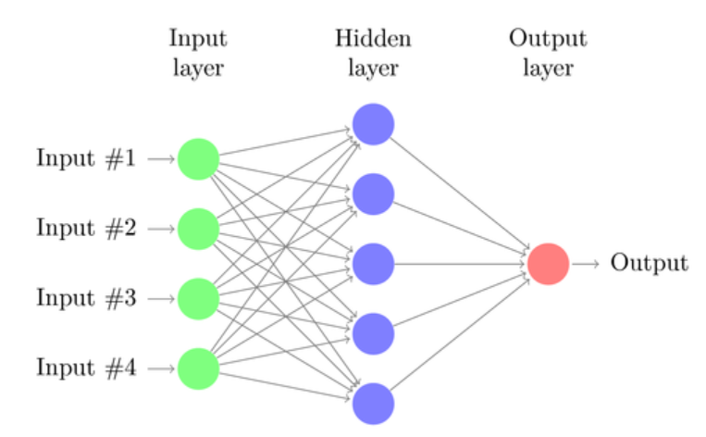
Our first try: a multi-layer perceptron
Weights tuned during training
in [0, 1]
0 = C
1 = A
Shape: 1D vector of length
64*256=16384
Constructs non-linear mappings
Notes:
“Flatten” these maps and feed into the network, one at a time

Slide 12
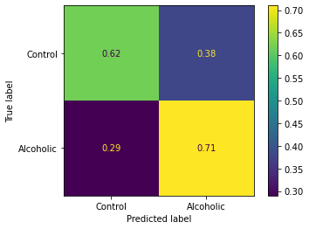
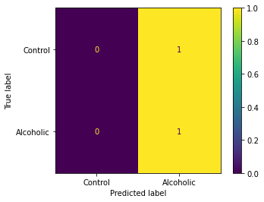
Initial results from the MLP classifier
Performance on the pre-selected testing set, ~67% accuracy
But doesn’t generalize to the full dataset at all!

Slide 13
Towards a better approach
Pre-selected samples don’t generalize. Use the full dataset for training
Avoid flattening images, use a Convolutional Neural Network (CNN)

Slide 14
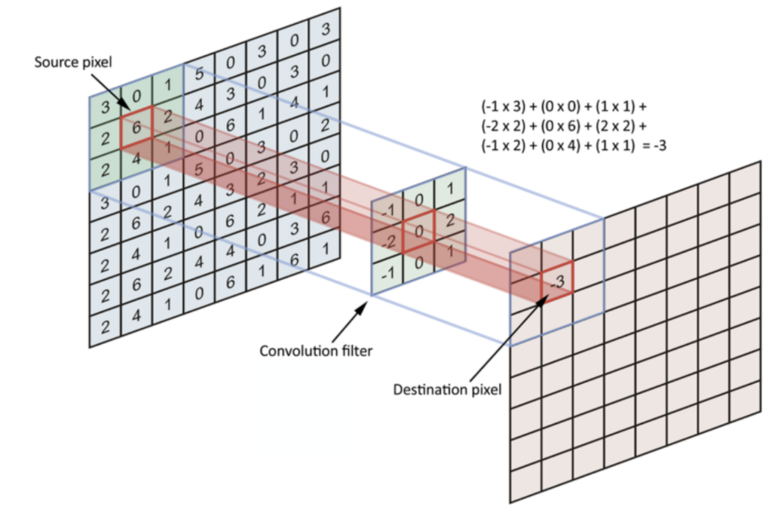
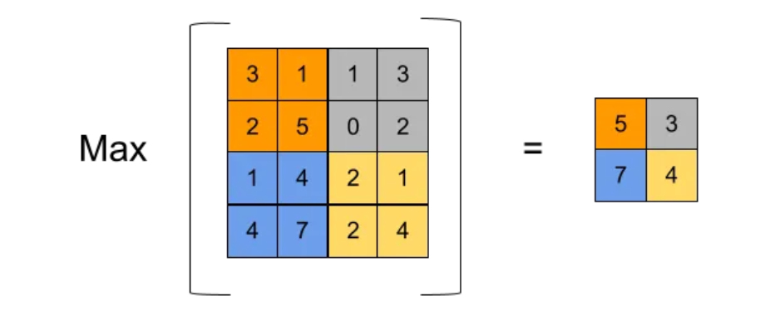
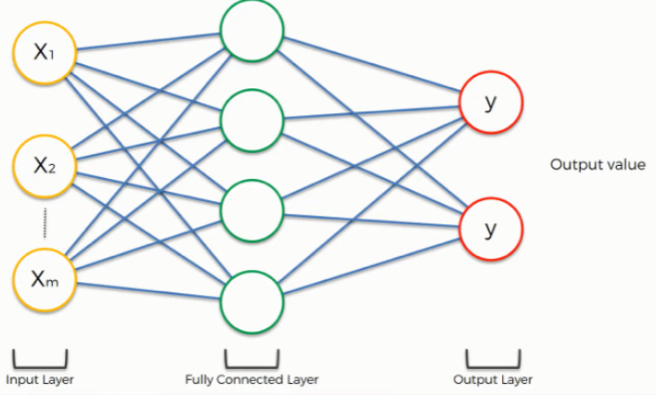
Our CNN Structure
Convolutional Layer
MaxPooling Layer
Fully Connected Layer
https://androidkt.com/explain-pooling-layers-max-pooling-average-pooling-global-average-pooling-and-global-max-pooling/
https://www.superdatascience.com/blogs/convolutional-neural-networks-cnn-step-4-full-connection
https://towardsdatascience.com/simple-introduction-to-convolutional-neural-networks-cdf8d3077bac#:~:text=Convolutional%20layers%20are%20the%20layers,the%20size%20of%20the%20kernels
Notes:
Traditional neural networks lose information by flattening images
CNNs can pick out the correlation between nearby pixels to extract features from the image
The number of weights to train in a CNN are fewer, so training is cheaper!

Slide 15
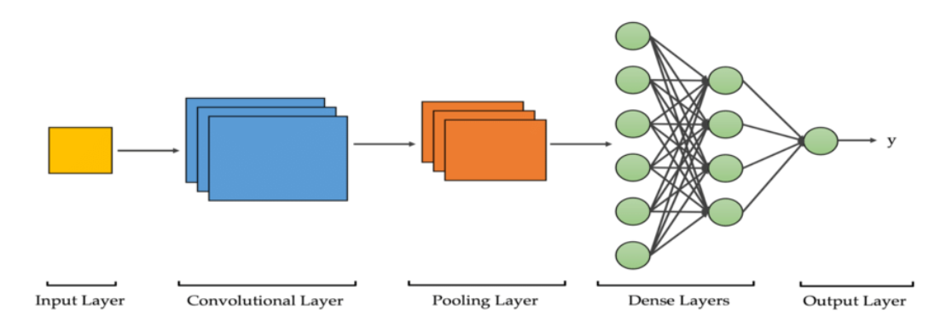
Our CNN structure
https://medium.com/swlh/an-overview-on-convolutional-neural-networks-ea48e76fb186
Notes:
Optimization technique: Stochastic Gradient Descent
Fixed regularizations to avoid overfitting
Optimized number of nodes in convolutional/ dense layers (~100 models)
Figuring out the best possible model was quite a challenging task, which took about 10-15 hours of work (manual + automatic hyperparameter tuning combined)!
We first decided to stick with a simple/ minimal architecture in terms of type of layers. Input layer taking in 64x256 images, a convolutional layer that picks on features from these images, a max pooling layer that performs dimensionality reduction, feeding into a regular dense layer, finally leading to a probabilistic output.
In a plethora of optimization techniques, we chose stochastic gradient descent, which adapts well to bulky training sets (like ours!) We also chose a suitable learning rate to allow fast enough convergence but now skip around local minima
We implemented regularizers, which are parameters added to the cost function to penalize overfitting. Again, we had to find a balance between overfitting and underfitting.
With all of these choices fixed, we finally let a keras implementation of cross-validation based grid search optimize the number of nodes in the convolutional and dense layer. We specified search ranges for both hyperparameters to be centered at good values we found by trial and error. We tried out a hundred models based on layer sizes, and thus arrived at our best model!

Slide 16
STRUCTURE OF THE NETWORK
After many trials, we decided on a baseline model with 1 convolutional, 1 MaxPooling, and 1 dense layer.
Given the computational cost of training a complex algorithm on the full EEG dataset, naively tuning all hyperparameters (number of perceptrons in each layer, learning rate, regularizations etc.) is not possible.
We need a good base estimate for various hyperparameters. Then, we can choose some of these, varying them within a small range to get a the best possible model.

Slide 17
FINE TUNING
To find a baseline model we tried (~10-15 hours of work!):
Different optimizers (Adam/ Stochastic Gradient Descent)
Different network structures
Number/ type of layers
Neurons in each layer
Activation functions
Introducing regularization
Varying the number of epochs
We then optimized the number of neurons in each layer using keras_tuner

Slide 18
MODEL SUMMARIES
S1
S2 Match
S2 Non-Match
Model: "sequential"
_________________________________________________________________
Layer (type) Output Shape Param #
=================================================================
conv2d (Conv2D) (None, 60, 237, 23) 2323
max_pooling2d (MaxPooling2D (None, 20, 19, 23) 0
)
flatten (Flatten) (None, 8740) 0
dense (Dense) (None, 19) 166079
dense_1 (Dense) (None, 1) 20
=================================================================
Total params: 168,422
Trainable params: 168,422
Non-trainable params: 0
_________________________________________________________________
Model: "sequential"
_________________________________________________________________
Layer (type) Output Shape Param #
=================================================================
conv2d (Conv2D) (None, 60, 237, 21) 2121
max_pooling2d (MaxPooling2D (None, 20, 19, 21) 0
)
flatten (Flatten) (None, 7980) 0
dense (Dense) (None, 13) 103753
dense_1 (Dense) (None, 1) 14
=================================================================
Total params: 105,888
Trainable params: 105,888
Non-trainable params: 0
_________________________________________________________________
Model: "sequential"
_________________________________________________________________
Layer (type) Output Shape Param #
=================================================================
conv2d (Conv2D) (None, 60, 237, 29) 2929
max_pooling2d (MaxPooling2D (None, 20, 19, 29) 0
)
flatten (Flatten) (None, 11020) 0
dense (Dense) (None, 13) 143273
dense_1 (Dense) (None, 1) 14
=================================================================
Total params: 146,216
Trainable params: 146,216
Non-trainable params: 0
___________________________________________________________________

Slide 19
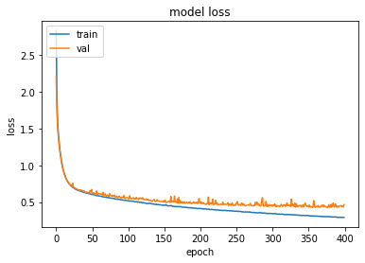
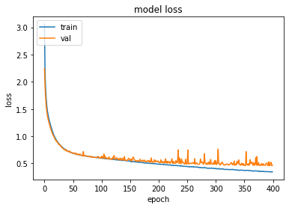
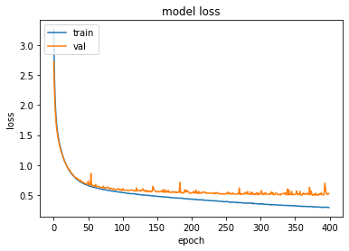
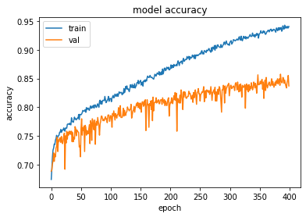
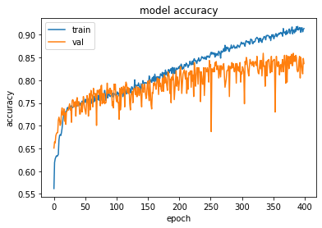
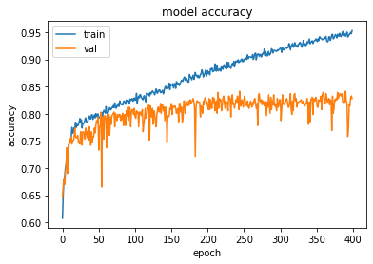
MODEL TRAINING
S1
S2 Match
S2 Non-Match

Slide 20
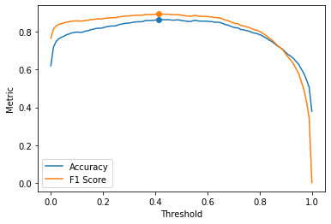
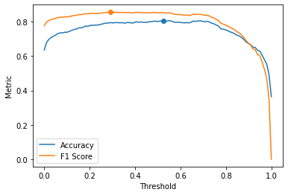

THRESHOLD CHOICE
S1
S2 Match
S2 Non-Match
Accuracy - 86.59%
Threshold - 0.414
Accuracy - 80.62%
Threshold - 0.525
Accuracy - 83.72%
Threshold - 0.545

Slide 21
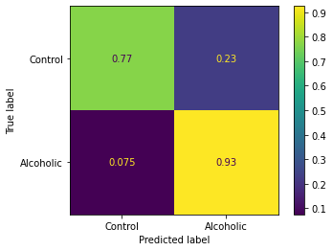
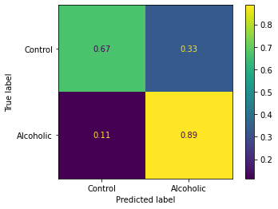

Model evaluation
S1
S2 Match
S2 Non-Match
Accuracy - 86.59%
Accuracy - 80.62%
Accuracy - 83.72%
AUDIT level accuracies, but with objectivity!
Notes:
The model training was great success!
We get 87% accuracy for the single stimulus, and about 80-84% accuracy for the two stimuli cases - audit level, but achieved systematically through objectively defined metrics!
Alcoholism prediction does even better than overall accuracy, models err on the side of caution and specify some controls as alcoholics. This is okay, because the point is to detect alcoholism!
We did say that S1 is the less interesting of stimuli compared to S2 match/ non-match. Why does it have a higher accuracy then? Well, in the full dataset, we had about twice the number of samples for S1 compared to S2 match/ non-match, and CNN accuracies rely heavily on training volume. So all things considered, S2 non-match is still probably the best kind of stimulus for differentiating among alcoholics and control subjects.

Slide 22
True positive rate
Notes:
Needless to say, there are many things to improve here, we have barely scratched the surface. We have the following ideas to improve the model’s performance in the future -
Try out more model architectures, do better hyperparameter tuning! CNNs are convoluted creatures, and there are many moving parts, and it would help to understand how CNNs work from the ground up and see if that could aid performance.
We would certainly need to revisit feature engineering. We could look at feature maps produced by the CNNs, which are essentially latent representations of the images fed in to the network to see if we could make something out of it. We would also want to examine cross-correlations numerically across signals of alcoholics and controls, and figure perhaps use PCA/ ICA to perform noise reduction.
Just treating this puzzle as an image classification problem has the disadvantage of taking away causality from the picture - at the end of the day, our data is a plethora of time series, and recurrent neural networks are better suited to dealing with them. Perhaps we could combine both CNNs and RNNs in some meaningful way!
Lots more to do, but we tried out best to come up with a consistent model in two weeks that performed at least as well as AUDIT, but was objective, and we feel very happy about our results!

Slide 23
Reflections
Develop better CNN architecture
Revisit feature engineering
Dimensionality reduction using feature maps
Noise elimination using SVD/wavelet transform
Try out Recurrent Neural Networks (RNNs)
Notes:
Needless to say, there are many things to improve here, we have barely scratched the surface. We have the following ideas to improve the model’s performance in the future -
Try out more model architectures, do better hyperparameter tuning! CNNs are convoluted creatures, and there are many moving parts, and it would help to understand how CNNs work from the ground up and see if that could aid performance.
We would certainly need to revisit feature engineering. We could look at feature maps produced by the CNNs, which are essentially latent representations of the images fed in to the network to see if we could make something out of it. We would also want to examine cross-correlations numerically across signals of alcoholics and controls, and perform noise reduction.
Just treating this puzzle as an image classification problem has the disadvantage of taking away causality from the picture - at the end of the day, our data is a plethora of time series, and recurrent neural networks are better suited to dealing with them. Perhaps we could combine both CNNs and RNNs in some meaningful way!
Lots more to do, but we tried out best to come up with a consistent model in two weeks that performed at least as well as AUDIT, but was objective, and we feel very happy about our results!

Slide 24
Thanks for tuning in!
Questions?

